Slide 1
ITP05 INFORMATION MANAGEMENT
Hospital Management
System
Entity-Relationship Diagram & SQL Implementation
GROUP 1
Submitted to: Lance Jericho R. Salcedo
Faculty, School of Information Technology Education
Universidad de Dagupan

Slide 2
System Overview
What the System Does
A Hospital Management System is a database-driven information system that centralizes patient, medical, administrative, and financial records into a single relational database which improves efficiency, consistency, and accessibility of hospital information.
Patient Services
Clinical Management
Administration
Registration, admissions, appointments, allergies, discharge
Medical records, prescriptions, doctor & nurse coordination
Room management, billing, departmental operations
Key Stakeholders
Hospital Administrators
Doctors
Nurses
Patients
Billing Staff
Records Officers

Slide 3
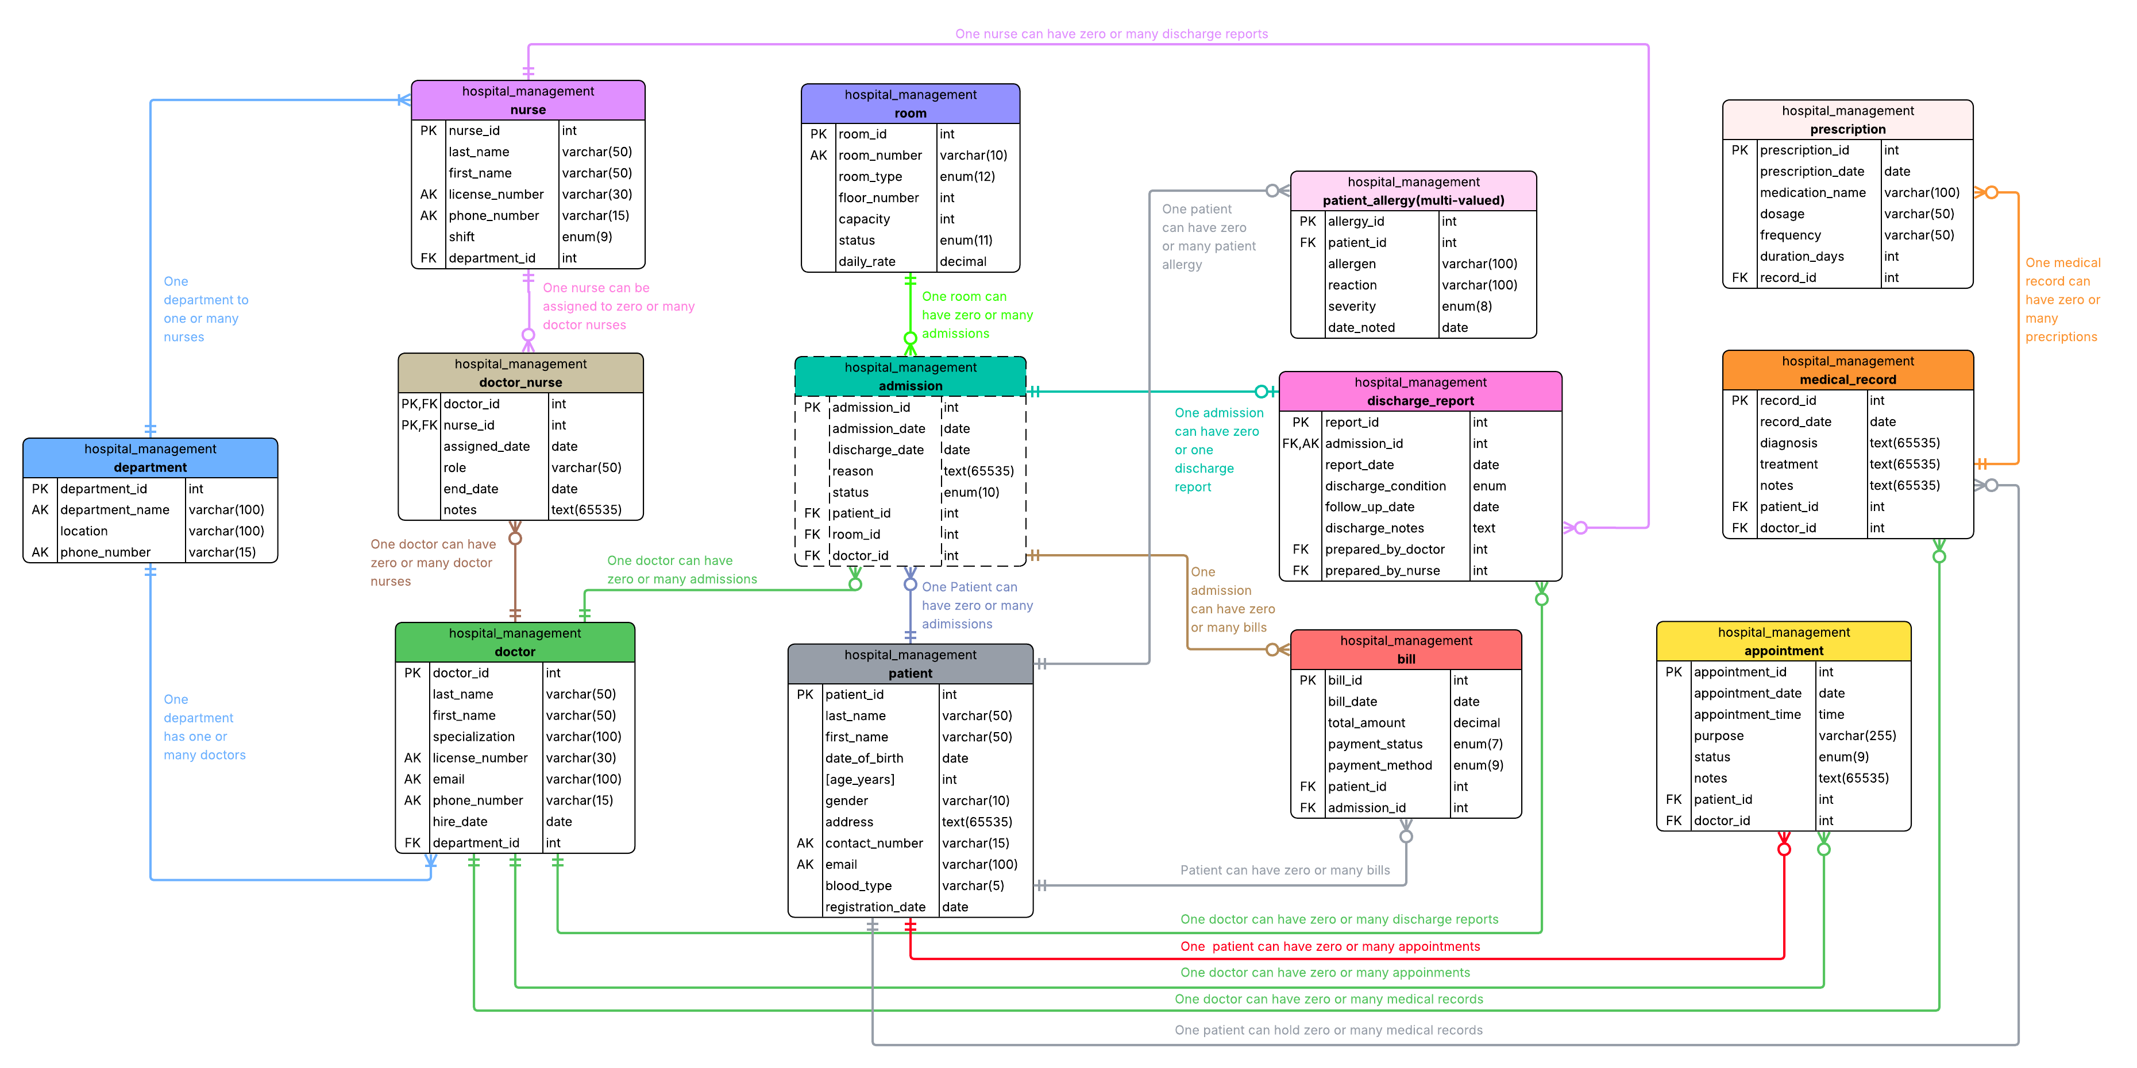
ERD Walkthrough

Slide 4
Entities at a Glance
Department
Doctor
Nurse
Root entity
Medical staff with specialization
Clinical support staff
Patient
Room
Admission
Core entity of the system
Hospital resource management
Weak entity — inpatient stays
Appointment
MedicalRecord
Prescription
Outpatient consultations
Clinical diagnoses & treatments
Medication prescriptions per record
Bill
PatientAllergy
Doctor_Nurse
Financial billing records
Multi-valued — patient allergies
Bridge table — M:N relationship
DischargeReport
1:1 with Admission (UNIQUE FK)

Slide 5
Key Relationships & Cardinality
Relationship
Cardinality
Participation
SQL Enforcement
Doctor → Department
N:1
Total (Doctor)
FK department_id in Doctor
Patient → Admission
1:N
Total (Admission)
FK + ON DELETE CASCADE
Patient ↔ Doctor
M:N
Partial (both)
Appointment bridge table
Doctor ↔ Nurse
M:N
Partial (both)
Doctor_Nurse bridge table
MedicalRecord → Prescription
1:N
Partial (MedRecord)
FK record_id + ON DELETE CASCADE
Admission ↔ DischargeReport
1:1
Partial (Admission)
UNIQUE constraint on FK
Patient → Bill
1:N
Partial (Patient)
FK; admission_id SET NULL
Admission → Room
N:1
Total (Admission)
FK room_id in Admission

Slide 6
Key Design Decisions
Why a Weak Entity was Used — Admission
01
Admission is existentially dependent on Patient and it cannot exist without one. We modeled it as a weak entity and enforced this with ON DELETE CASCADE on patient_id, so removing a patient automatically clears all their admission records.
How the M:N was Resolved — Doctor & Nurse
02
Doctors and Nurses have a many-to-many relationship. We resolved this by creating the Doctor_Nurse bridge table with a composite PK (doctor_id, nurse_id), allowing multiple nurses to assist multiple doctors while keeping each assignment unique.
Why ON DELETE SET NULL — Bill.admission_id
03
Billing records must survive even if the linked admission is deleted. We chose SET NULL for Bill.admission_id so financial history is preserved and the bill stays, but the broken admission refer ence is simply cleared.

Slide 7
SQL Implementation Highlights
1. Patient Table
2. Admission Table (Weak Entity)
CREATE TABLE patient (
patient_id INT PRIMARY KEY AUTO_INCREMENT,
last_name VARCHAR(50) NOT NULL,
first_name VARCHAR(50) NOT NULL,
date_of_birth DATE NOT NULL,
age_years INT AS (TIMESTAMPDIFF(YEAR, date_of_birth, CURDATE()))
VIRTUAL,
gender VARCHAR(10) NOT NULL,
contact_number VARCHAR(15) UNIQUE,
email VARCHAR(100) UNIQUE,
blood_type VARCHAR(5),
registration_date DATE NOT NULL
DEFAULT (CURRENT_DATE)
);
CREATE TABLE admission (
admission_id INT PRIMARY KEY AUTO_INCREMENT,
admission_date DATE NOT NULL,
discharge_date DATE,
reason TEXT NOT NULL,
status ENUM('Admitted','Discharged') NOT NULL DEFAULT 'Admitted',
patient_id INT NOT NULL,
room_id INT NOT NULL,
doctor_id INT NOT NULL,
FOREIGN KEY (patient_id) REFERENCES patient(patient_id)
ON DELETE CASCADE ON UPDATE CASCADE,
FOREIGN KEY (room_id) REFERENCES room(room_id)
ON DELETE RESTRICT ON UPDATE CASCADE,
FOREIGN KEY (doctor_id) REFERENCES doctor(doctor_id)
ON DELETE RESTRICT ON UPDATE CASCADE
);
age_years is a VIRTUAL derived column which computed automatically from date_of_birth using TIMESTAMPDIFF(). It was never stored manually.
ON DELETE CASCADE on patient_id removes admissions when a patient is deleted. RESTRICT on room/doctor prevents accidental deletion of referenced records.

Slide 8
Challenges Encountered
01 Modeling the Weak Entity
02 Resolving M:N Relationships
Challenge:
Challenge:
Deciding how to correctly implement Admission as a weak entity was tricky since SQL does not natively support the concept.
Doctor ↔ Nurse and Patient ↔ Doctor both required M:N handling, which cannot be directly stored in relational tables.
Resolution:
Resolution:
We used a surrogate AUTO_INCREMENT PK for implementation convenience and enforced dependency via ON DELETE CASCADE on the patient_id FK.
Created Doctor_Nurse and Appointment as bridge/associative tables with composite or surrogate PKs and FKs to both parent tables.
03 Choosing Correct ON DELETE Rules
04 ERD Layout & Readability
Challenge:
Challenge:
Determining which FK action (CASCADE, RESTRICT, SET NULL) was appropriate for each relationship required careful analysis.
With 13 entities and numerous relationships, the ERD diagram became cluttered and difficult to read at first.
Resolution:
Resolution:
We mapped each relationship's dependency: CASCADE for child-only entities, RESTRICT for critical references, SET NULL for optional links like Bill → Admission.
We reorganized entities by logical grouping (admin, clinical, financial) and used color-coded tables in draw.io to improve clarity.

Slide 9
Q & A
Questions & Answers
Hospital Management System | Group 1 | ITP05 Information Management
ERD Concepts
Design Choices
SQL Constraints
Schema Modifications

